Slide 1
Web Apps Frameworks
Pravin Y Pawar

Slide 2
Web App Framework
Defined
A framework is a library that offers opinions about how software gets built.
Web application framework (WAF)
software framework that is designed to support the development of web applications including
web services
web resources
web APIs
Provide a standard way to build and deploy web applications on the World Wide Web including support for
libraries for database access
templating frameworks
session management etc.
Two types
Client side
Server Side

Slide 3
Client-Side Programming
Frontend / User Interface
Involves everything users see on their screens.
Major frontend technology stack components:
HTML, CSS and JS
Hypertext Markup Language (HTML) and Cascading Style Sheets (CSS)
HTML tells a browser how to display the content of web pages
CSS styles that content
Bootstrap is a helpful framework for managing HTML and CSS
JavaScript (JS)
Makes web pages interactive
Many JavaScript libraries (such as jQuery, React.js)
frameworks (such as Angular, Vue, Backbone, and Ember)

Slide 4
Server-Side Programming
Backend
Not visible to users, but it powers the client side
Major server side technology stack components:
Programming language, Framework , web server and databases
Server-side programming languages used to create the logic of applications
Frameworks offer lots of tools for simpler and faster development of applications
Options
Ruby (Ruby on Rails)
Python (Django, Flask, Pylons)
PHP (Laravel)
Java (Spring)
Scala (Play)
Javascript (Node.js)

Slide 5
Server-Side Programming
Other Components
Storage
Apps needs a place to store its data
Two types of databases:
relational and non-relational
Most common databases for web development:
MySQL (relational)
PostgreSQL (relational)
MongoDB (non-relational, document)
Caching system
Used to reduce the load on the database and to handle large amounts of traffic
Memcached and Redis are the most widespread
Web servers
Needs a server to handle requests from clients’ computers
Two major players:
Apache
Nginx

Slide 6
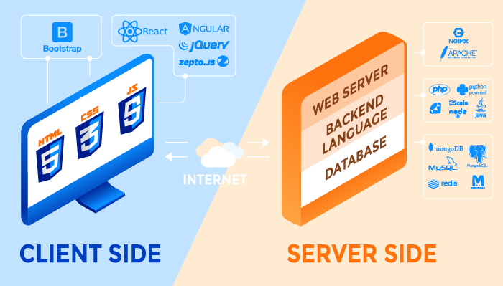
Web App Tech Stack
Modern Tech Stack
Source : RubyGarage

Slide 7
Thank You!
In our next session:

